Slide 1
Heavy Photon Search and the
Hunt for True Muonium
SLAC Lab
Harry Myers - July 2025

Slide 2

Summary
Hi everyone, my name is Harry Myers. I moved to the U.S. from England in 2011 and am currently studying at UCLA. Outside of school, I enjoy skateboarding, scuba diving, and tennis, and I work part-time at a tennis pro shop three days a week. As part of my transfer journey to UCLA, I had the opportunity to take a gap semester, which I used to travel across Asia—visiting six countries over the span of six months.
Short Term Goals:
Get more comfortable with web dev specifically Javascript
Program TM visualizations using C++, python, and Root
End of Summer:
Finish learning React
A1 German. Ich habe drei Monate lang Deutsch gelernt
End of Year:
Complete an AI focused resume project with a beautiful React front end.
Deploy personal website that showcases projects I have worked on
Education
Upperclassman at UCLA Samueli school of Engineering studying Computer Science
Harry Myers
harrymyers257@gmail.com 650.223.9647
LinkedIn
Location: Palo Alto, CA

Slide 3
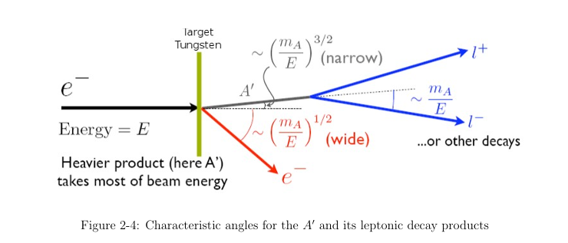
What is Heavy Photon Search (HPS)?
An experiment designed to search for a hypothetical particle called a heavy photon
What is a heavy photon?
Similar to a regular photon but believed to have a small amount of mass
Thought to be a sort of dark counterpart to light and might be able to interact with dark matter
Potentially lead to the discovery of a new fundamental force and provide insights into the nature of dark matter.
Heavy photons are predicted to interact weakly with observable matter, making them difficult to detect directly. This weak interaction implies that they might have a relatively long lifetime and travel some distance before decaying
How does the Search Work?
The HPS experiment uses a beam of electrons that are fired at a target containing a heavy nuclei such as tungsten
If heavy photons exist, they could be produced in these collisions through a process called bremsstrahlung
These heavy photons would quickly decay into an e⁺e⁻ pair
HPS detector is used to track the paths and energies of these electron-positron pairs, allowing scientists to reconstruct their origin and properties.

Slide 4
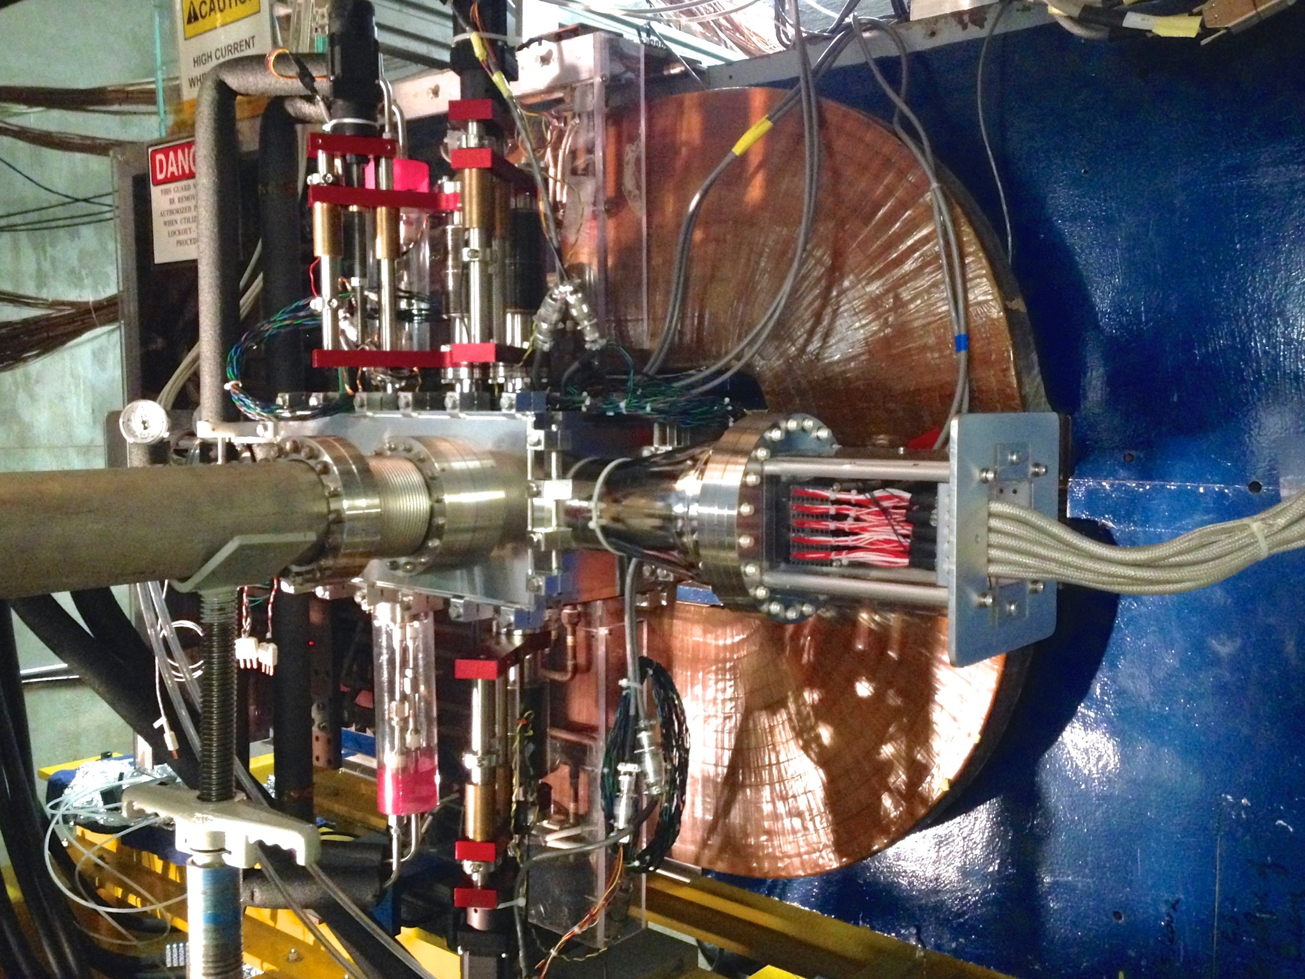
How does HPS detect displaced vertices?
HPS detector uses a Silicon Vertex Tracker (SVT), which consists of multiple layers of silicon microstrip sensors, to track the paths of e⁺e⁻
Designed to determine their momentum and trajectory and work back along their paths to where the pair originates, known as the decay vertex.
If the reconstructed decay vertex is found to be significantly separated from where the heavy photon would have been produced, it suggests the presence of a long-lived particle like a heavy photon.

Slide 5
What is True Muonium (μ+μ-)?
Theoretically predicted exotic atom composed of a muon (μ⁻) and an antimuon (μ⁺)
Muon is like an electron but more compact and ~207× heavier
Muonium is analogous to positronium (e⁺e⁻) — much more unstable
Short-lived (~picoseconds)
Purely QED system — no strong interaction
Smallest QED atom
512 fm Bohr radius smaller than that of hydrogen, ideal for precision tests of QED
Can be used to verify robustness of existing HPS software

Slide 6
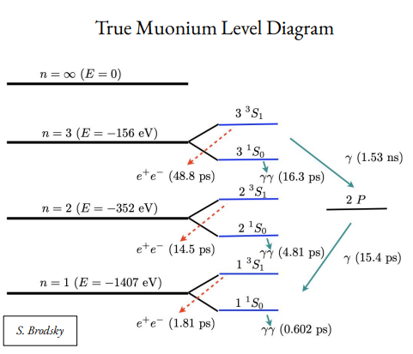
True Muonium Decay Modes
3³S₁ → e⁺e⁻ (observable in HPS)
3¹S₀ → γγ (shorter-lived, harder to detect)
The 3³S₁ state decays with a 50 ps lifetime, moves 1.5 cm before decaying to e⁺e⁻
Notes:
Excited state nrg level 3 is what were looking at: "The triplet S-one state of true muonium" 3³S₁ The superscript 3 indicates the triplet spin state (total spin = 1), meaning the spins of the muon and antimuon are aligned.
The S refers to the orbital angular momentum quantum number (L = 0).
The subscript 1 refers to the total angular momentum (J = 1).
singlet S-zero state: 3¹S₀
The superscript 1 means it's a singlet spin state (total spin = 0), so the muon and antimuon have opposite spins.
S again means orbital angular momentum L = 0.
Subscript 0 means the total angular momentum

Slide 7
How might TM be detected in HPS?
TM can be produced in the same way as heavy photons
The triplet state of TM is decays into an e⁺e⁻ pair identical to that of a heavy photon
The HPS detector is specifically designed to track and measure the properties of e⁺e⁻ pairs
TM travels a short distance before decaying at an angle relative to the beam direction
We can use this information to work back to the origin of the e⁺e⁻ pairs and check if they were once TM, much like in HPS.
Discovering True Muonium would be a significant breakthrough because it would be the first observation of this lepton-based bound state, providing a crucial test of our theory of Quantum Electrodynamics and potentially shedding light on new physics beyond the Standard Model

Slide 8
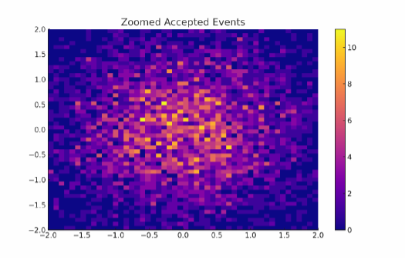
Moving Forward
Our goal is to collect data on TM that is produced at two different angles
The TM will decay into e⁺e⁻ and we want to determine how often those e⁺e⁻ pairs are detected
Calculate the detector acceptance rate: the fraction of how many of these pairs make it through the detector
Determine the acceptance rate for each of the angles we test

